Slide 1

Customer Shopping Behavior Analysis
Uncovering insights from transactional data to guide strategic business decisions.

Slide 2

Project Overview & Dataset Summary
Project Goal
Dataset Snapshot
Analyze 3,900 purchases to optimize operations, understand preferences, and enhance subscription strategies.
3,900 rows, 18 columns
Key features: demographics, purchase details, shopping behavior
Missing data: 37 values in Review Rating

Slide 3
Exploratory Data Analysis (Python)
01
02
03
Data Loading & Exploration
Missing Data Handling
Column Standardization
Imported data with pandas, checked structure and summary statistics.
Imputed missing Review Ratings using median per category.
Renamed columns to snake_case for readability.
04
05
Feature Engineering
Database Integration
Created age_group and purchase_frequency_days.
Loaded cleaned data into PostgreSQL for SQL analysis.

Slide 4

Key SQL Analysis Findings
Revenue by Gender
Top 5 Products by Rating
Female: $75,191
Gloves: 3.86
Sandals: 3.84
Boots: 3.82
Hat: 3.80
Skirt: 3.78
Male: $157,890

Slide 5

Shipping & Subscription Insights
Shipping Type Comparison
Subscribers vs. Non-Subscribers
Standard: $58.46 avg purchase
Subscribers: 1053 customers, $59.49 avg spend, $62,645 total revenue
Express: $60.48 avg purchase
Non-Subscribers: 2847 customers, $59.87 avg spend, $170,436 total revenue

Slide 6
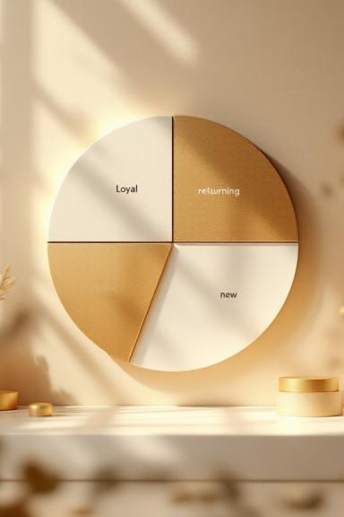
Discount & Segmentation
Discount-Dependent Products
Customer Segmentation
Hat: 50.00% discounted
Sneakers: 49.66% discounted
Coat: 49.07% discounted
Sweater: 48.17% discounted
Pants: 47.37% discounted
Loyal: 3116 customers
Returning: 701 customers
New: 83 customers

Slide 7

Product & Age Group Analysis
Top Products per Category
Revenue by Age Group
Young Adult: $62,143
Middle-aged: $59,197
Adult: $55,978
Senior: $55,763
Accessories: Jewelry, Sunglasses, Belt
Clothing: Blouse, Pants, Shirt
Footwear: Sandals, Shoes, Sneakers
Outerwear: Jacket, Coat

Slide 8

Repeat Buyers & Subscriptions
Subscription Status for Repeat Buyers
No: 2518 repeat buyers
Yes: 958 repeat buyers
Customers with >5 purchases are more likely to subscribe.

Slide 9
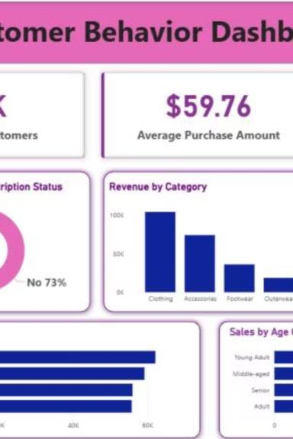
Power BI Dashboard: Visualizing Insights
Interactive dashboard presenting key customer behavior metrics.

Slide 10
Business Recommendations
Boost Subscriptions
Customer Loyalty
Review Discount Policy
Product Positioning
Reward repeat buyers.
Promote exclusive benefits.
Balance sales with margins.
Highlight top-rated items.
Targeted Marketing
Focus on high-revenue age groups.

